Slide 1
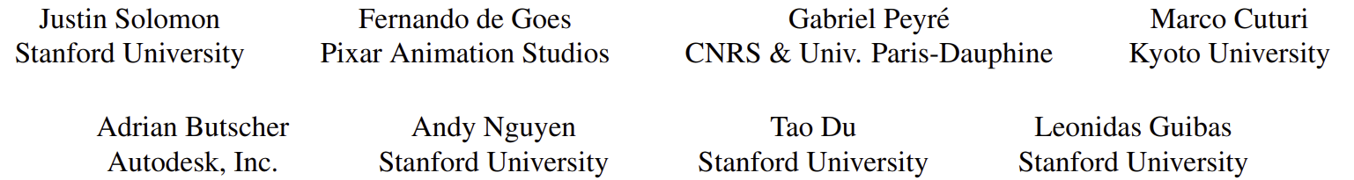
Convolutional Wasserstein Distances: Efficient Optimal Transportation on Geometric Domains
Alhussein Jamil, Jean-Baptiste Labit

Slide 2
TABLE OF CONTENTS
Theoretical introduction ( Reminder )
The Paper
a. Convolutional Wasserstein Barycenter
b. Heat Methods
Applications and examples

Slide 3
Optimal transport
Be able to compute the minimum path between 2 distributions
Allow to handle many various problems
Goal: manipulate distribution over geometric domains

Slide 4
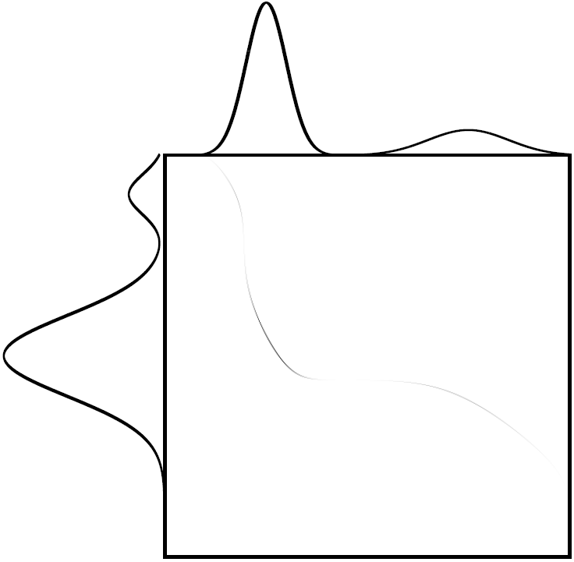
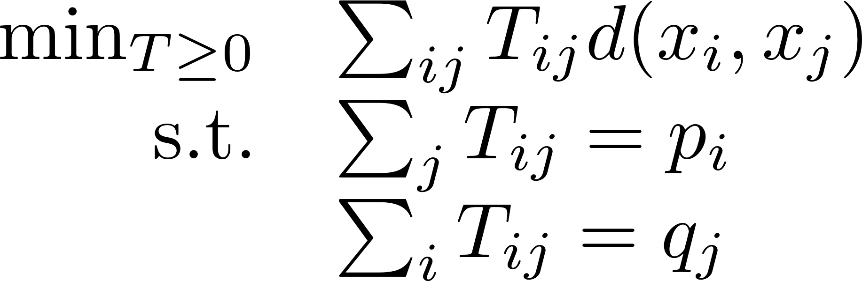





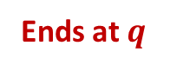
Earth mover distance
More sense than common euclidian distance
Represents the best way to move the mass from one point to another
mass $×$ distance
Starts at $p$
Ends at $q$

Slide 5
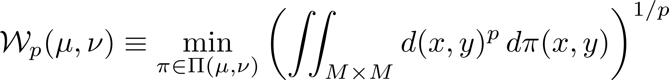
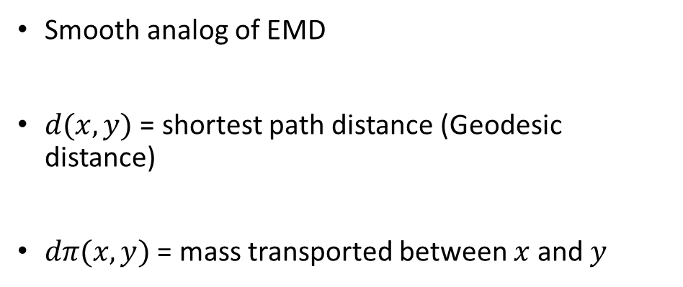
Wasserstein distance
Smooth analog of EMD
$d(x,y)$ = shortest path distance (Geodesic distance)
$dπ(x,y)$ = mass transported between $x$ and $y$

Slide 6
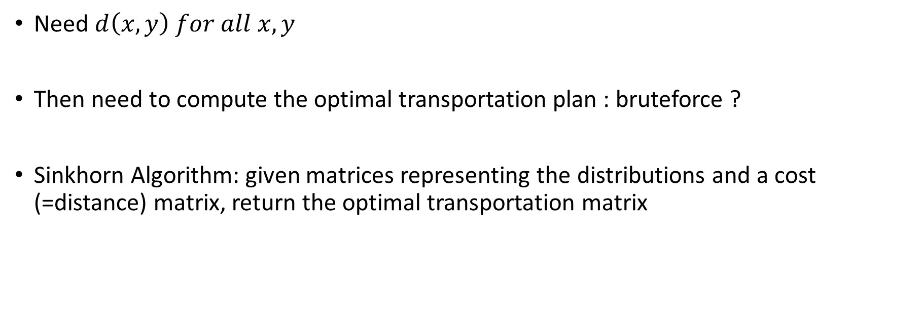
Computational issues
Need $d\left(x,y\right) for all x, y$
Then need to compute the optimal transportation plan : bruteforce ?
Sinkhorn Algorithm: given matrices representing the distributions and a cost (=distance) matrix, return the optimal transportation matrix

Slide 7
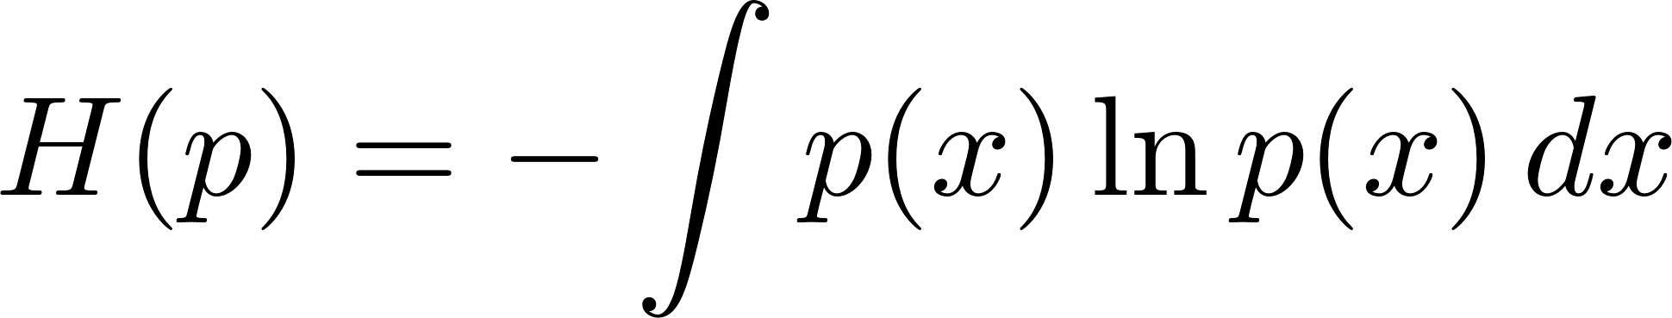
Optimization tricks: entropic regularization
Entropy
Regularizer
Smooth, convex optimization problem
Spread out the distribution, but allows a linear convergence of Sinkhorn

Slide 8
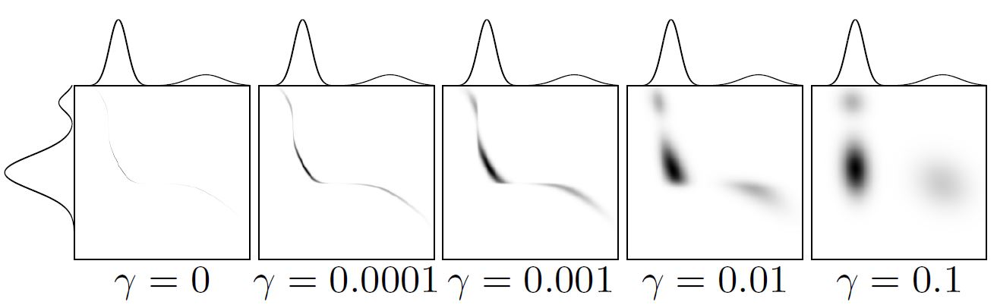
Optimization tricks: entropic regularization
The entropic regularization spreads out the distribution

Slide 9
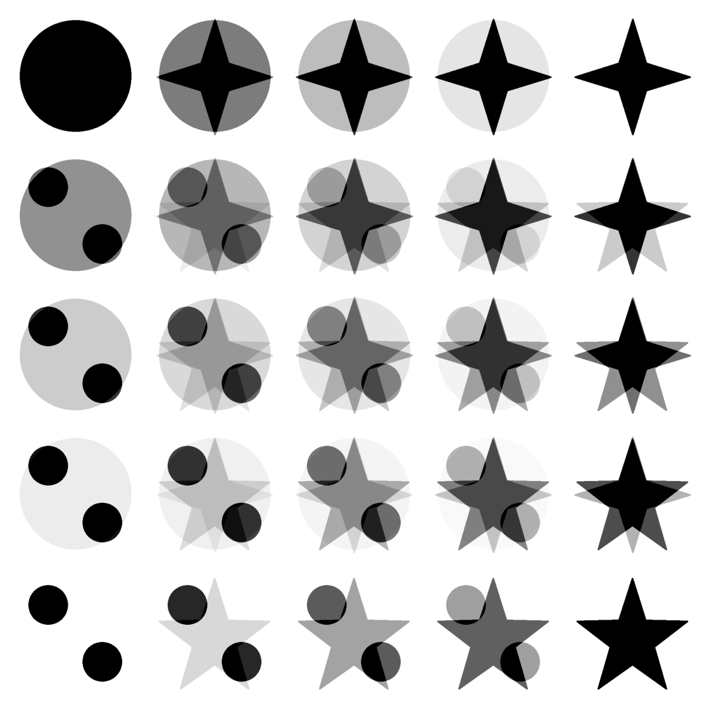

Why are we talking about this distance ?
It’s a much more natural way to express barycenters
(Like playing with playdoh !)
We’ll be concentrating on the barycenter aspect of the paper as it was the most interesting
Arithmetic barycenter

Slide 10
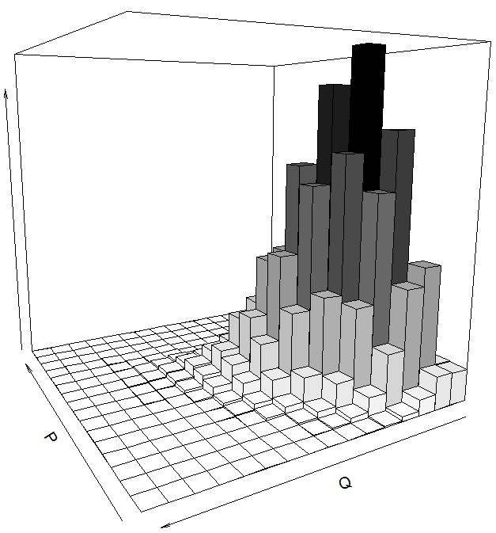
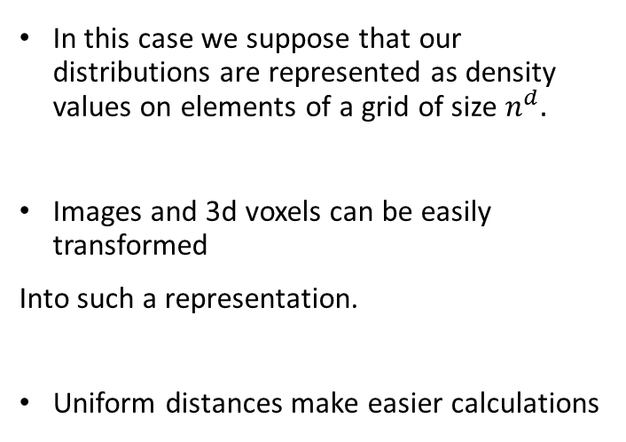
1) M is a d-dimensional grid
In this case we suppose that our distributions are represented as density values on elements of a grid of size $n^{d}.$
Images and 3d voxels can be easily transformed
Into such a representation.
Uniform distances make easier calculations

Slide 11
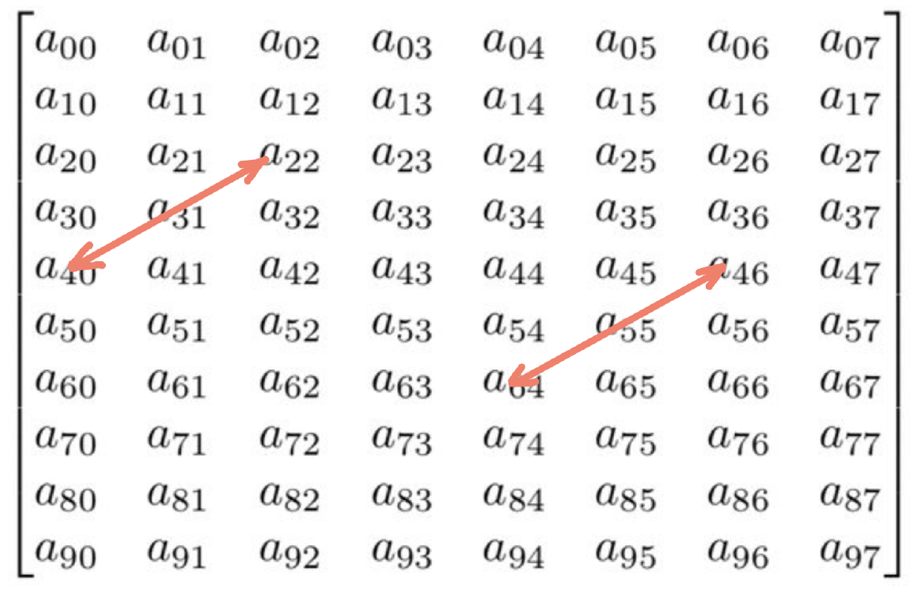
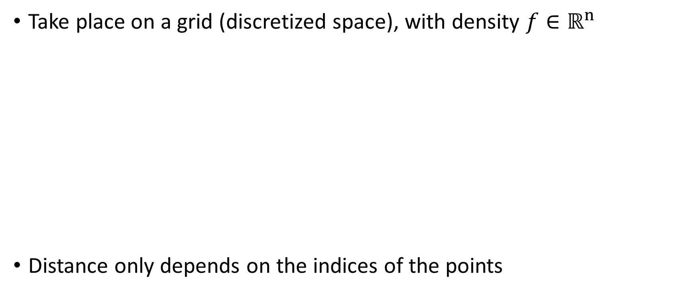
Convolutional Wasserstein distance
Take place on a grid (discretized space), with density $f∈ℝ^{n}$
Distance only depends on the indices of the points
Same distance

Slide 12
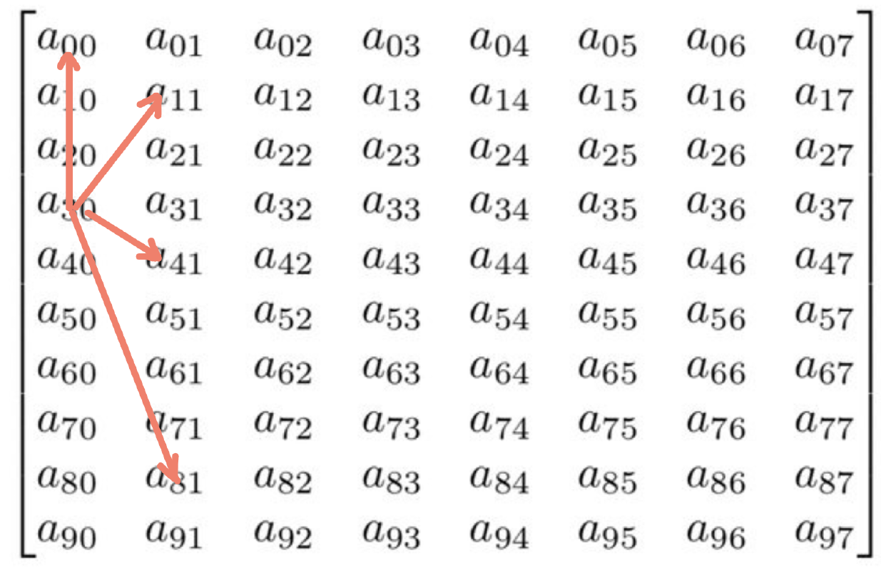
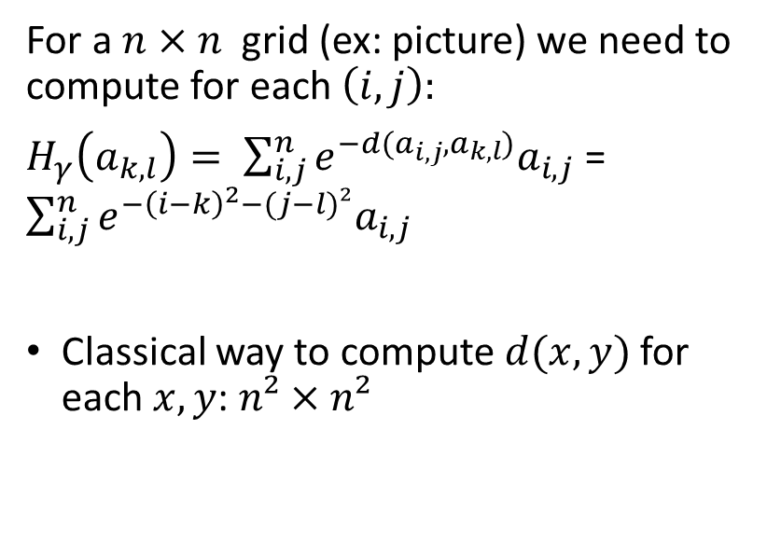
Convolutional Wasserstein distance
For a $n×n$grid (ex: picture) we need to compute for each $\left(i,j\right):$
$H_{γ}\left(a_{k,l}\right)= \sum_{i,j}^{n}{e^{−d(a_{i,j}, a_{k,l})}a_{i,j}}$ = $\sum_{i,j}^{n}{e^{−{\left(i−k\right)}^{2}−(j−l)²}a_{i,j}}$
Classical way to compute $d(x,y)$for each $x, y$: $n²×n²$

Slide 13
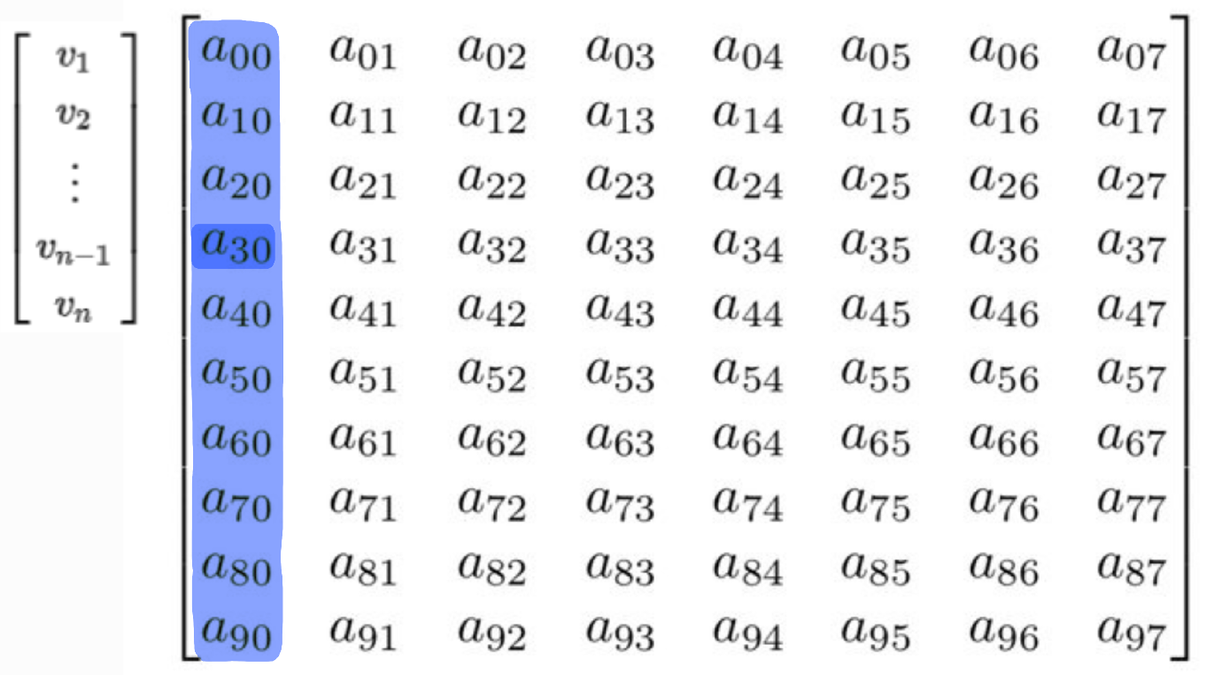
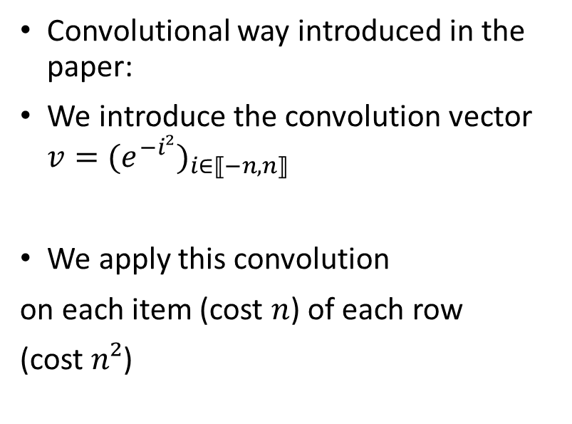
Convolutional Wasserstein distance
Convolutional way introduced in the paper:
We introduce the convolution vector ${v=(e^{−i²})}_{i∈⟦−n, n⟧}$
We apply this convolution
on each item (cost $n$) of each row
(cost $n²$)

Slide 14
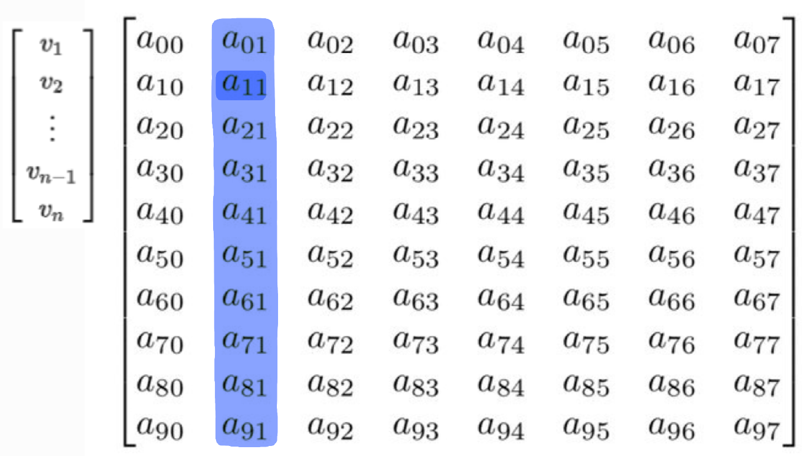
Convolutional Wasserstein distance
Convolutional way introduced in the paper:
We introduce the convolution vector ${v=(e^{−i²})}_{i∈⟦−n, n⟧}$
We apply this convolution
on each item (cost $n$) of each row
(cost $n²$)

Slide 15
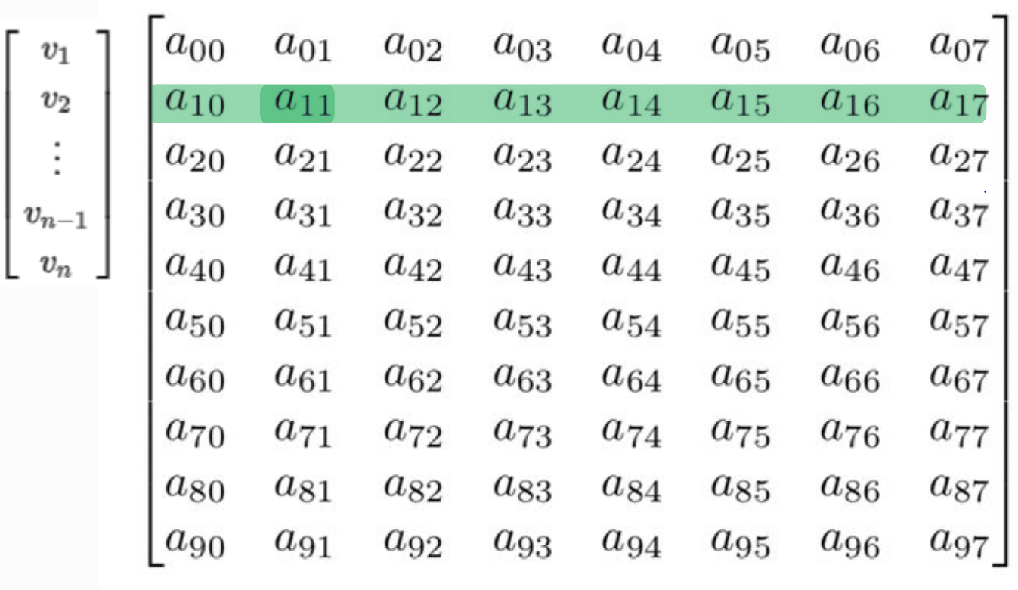
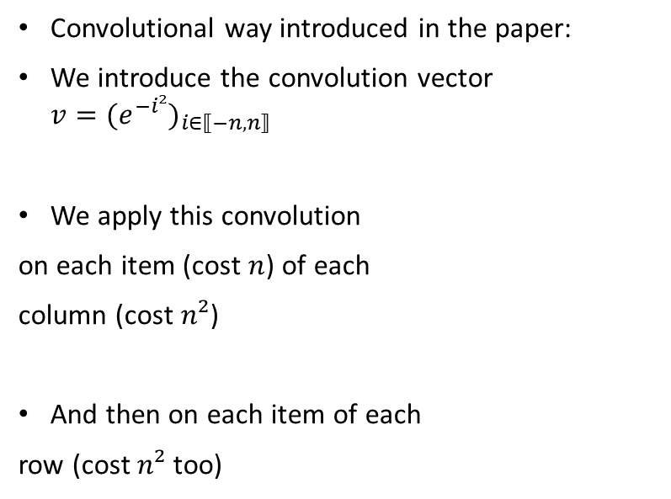
Convolutional Wasserstein distance
Convolutional way introduced in the paper:
We introduce the convolution vector ${v=(e^{−i²})}_{i∈⟦−n, n⟧}$
We apply this convolution
on each item (cost $n$) of each
column (cost $n²$)
And then on each item of each
row (cost $n²$ too)

Slide 16
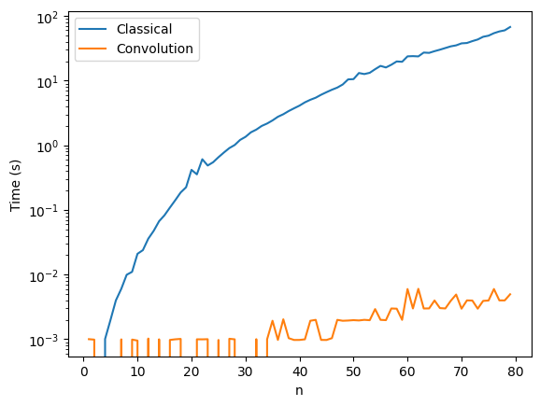
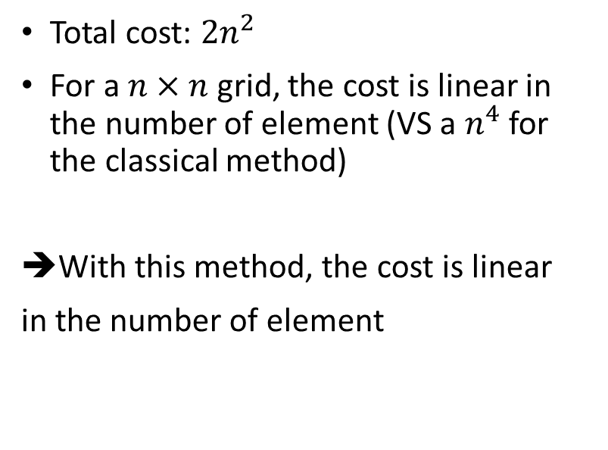
Convolutional Wasserstein distance
Total cost: $2n^{2}$
For a $n×n$ grid, the cost is linear in the number of element (VS a $n^{4}$ for the classical method)
With this method, the cost is linear
in the number of element

Slide 17
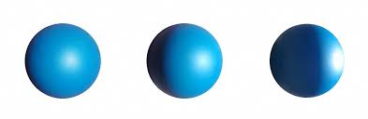
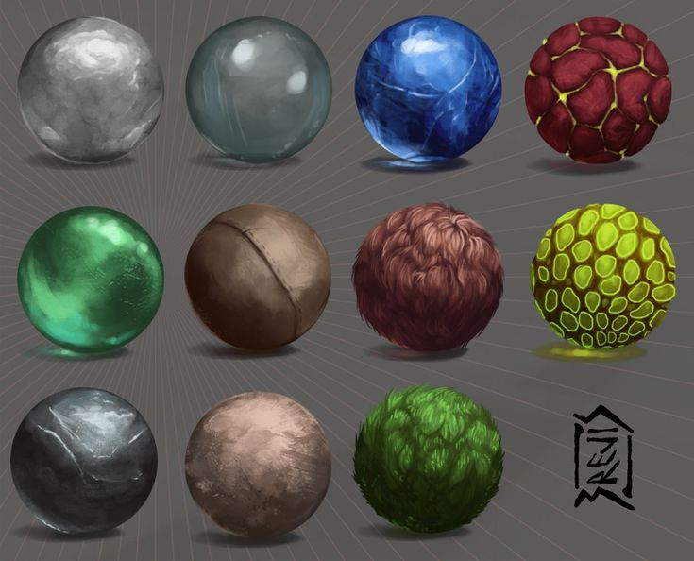
2) M is a mesh
Sometimes it is less convenient to use 3d grids to represent a certain distribution.
Examples :
3D applications
materials
light intensity
Topology of the earth's surface
can also be represented as a distribution over a sphere.

Slide 18
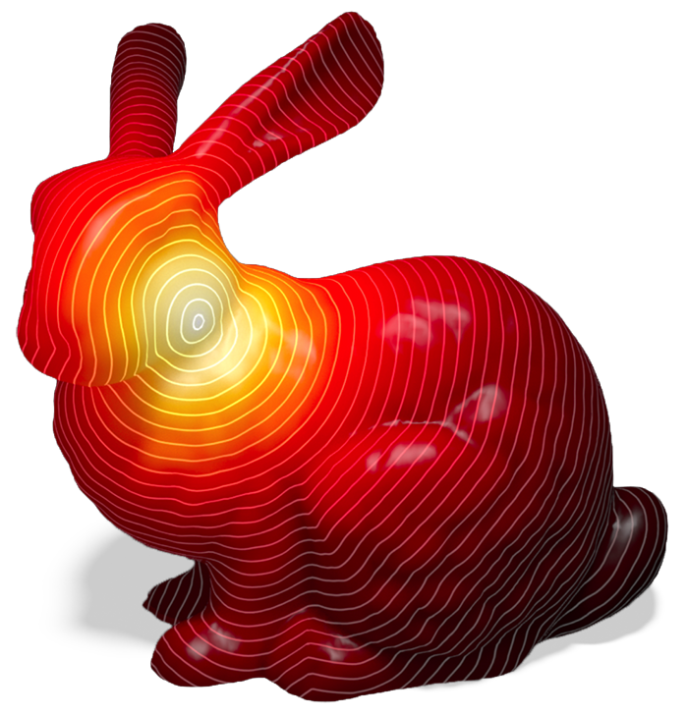
Heat methods
Convolution doesn’t work any more here !
Solution :
Use the solution to the heat equation to estimate pairwise distances much quicker.

Slide 19
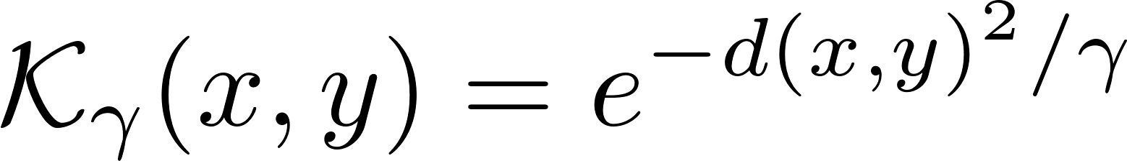
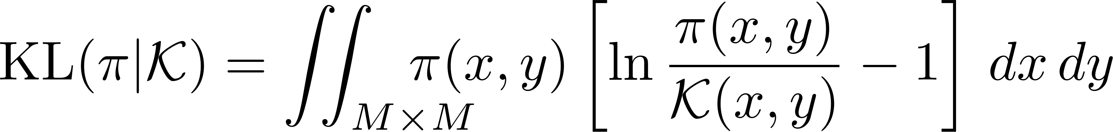
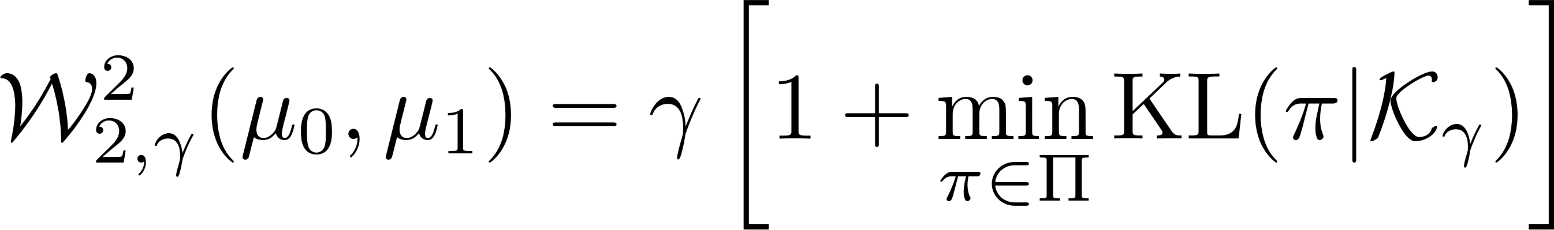
Optimization tricks: reformulation
« Heat kernel » represents pairwise distances
Permits reformulation
(Kullback-Leibler divergence)

Slide 20
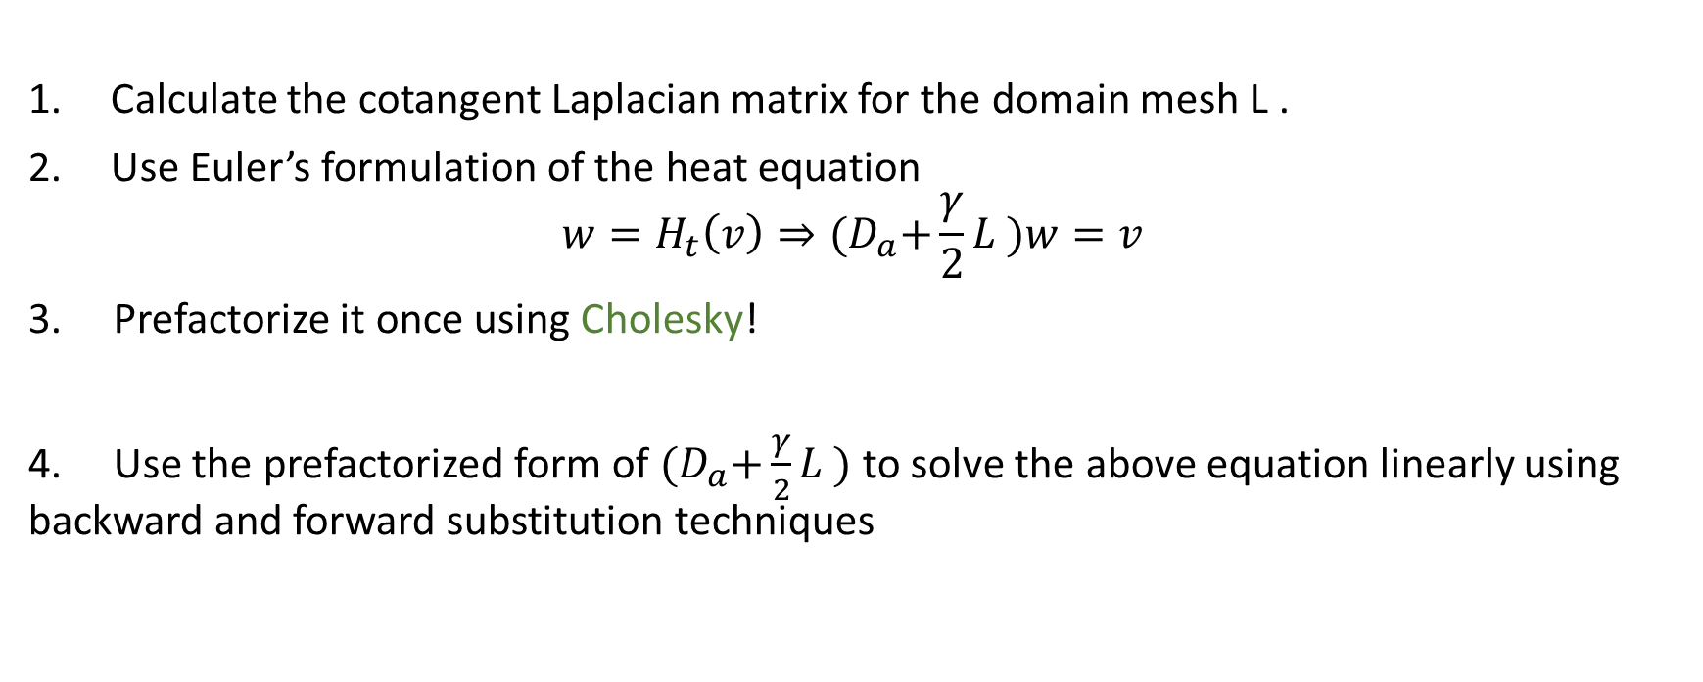
The approach :
Calculate the cotangent Laplacian matrix for the domain mesh L .
Use Euler’s formulation of the heat equation
$$w=H_{t}\left(v\right)⇒{(D}_{a}+\frac{γ}{2}L )w=v$$
3. Prefactorize it once using Cholesky!
4. Use the prefactorized form of ${(D}_{a}+\frac{γ}{2}L )$ to solve the above equation linearly using backward and forward substitution techniques

Slide 21
Applications

Slide 22
Applications
Applicable to distributions over grid
Interpolation, barycenters
Graphic rendering
Skeleton computation

Slide 23
2D Applications

Slide 24
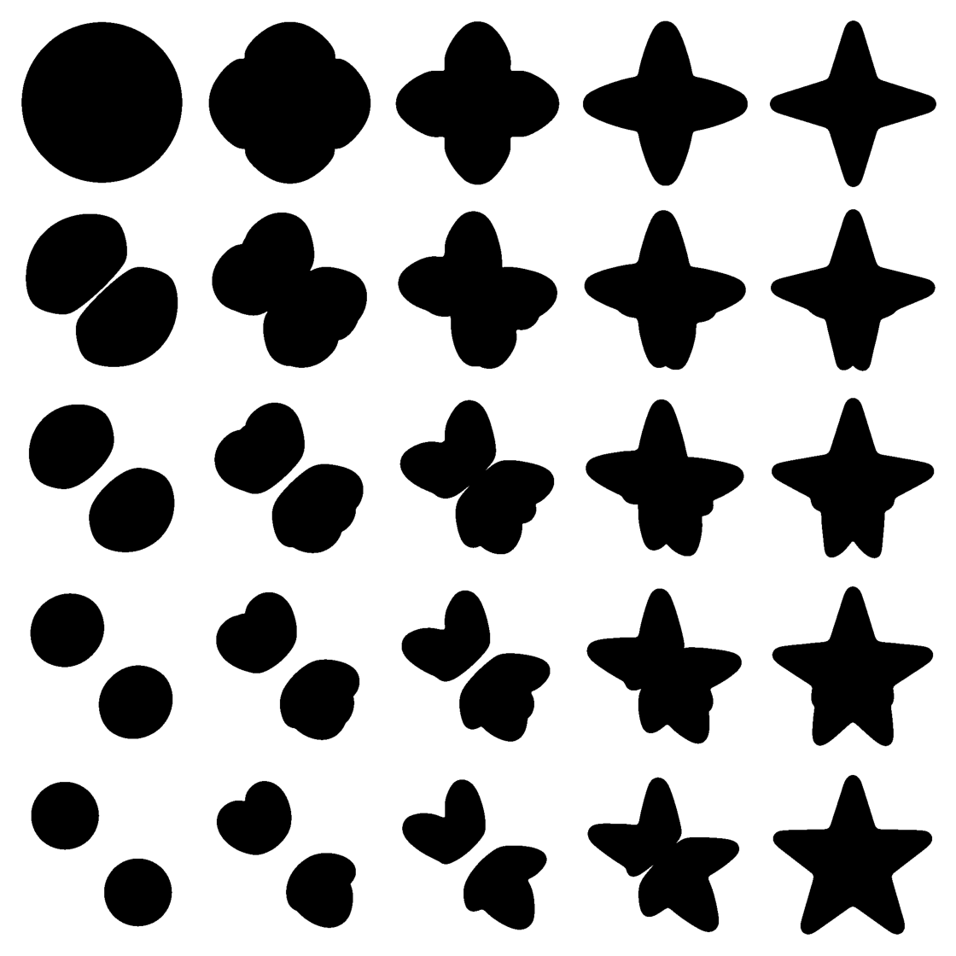

2D interpolation between binary images
Wasserstein Barycenter
Arithmetic Barycenter

Slide 25
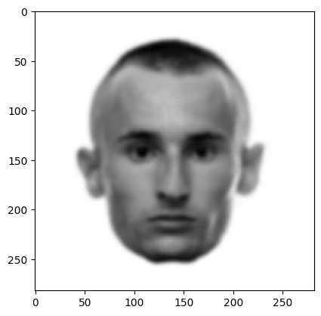
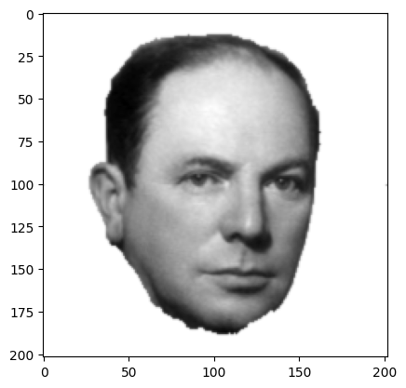
2D Interpolation Between Photos

Slide 26
3D Applications

Slide 27
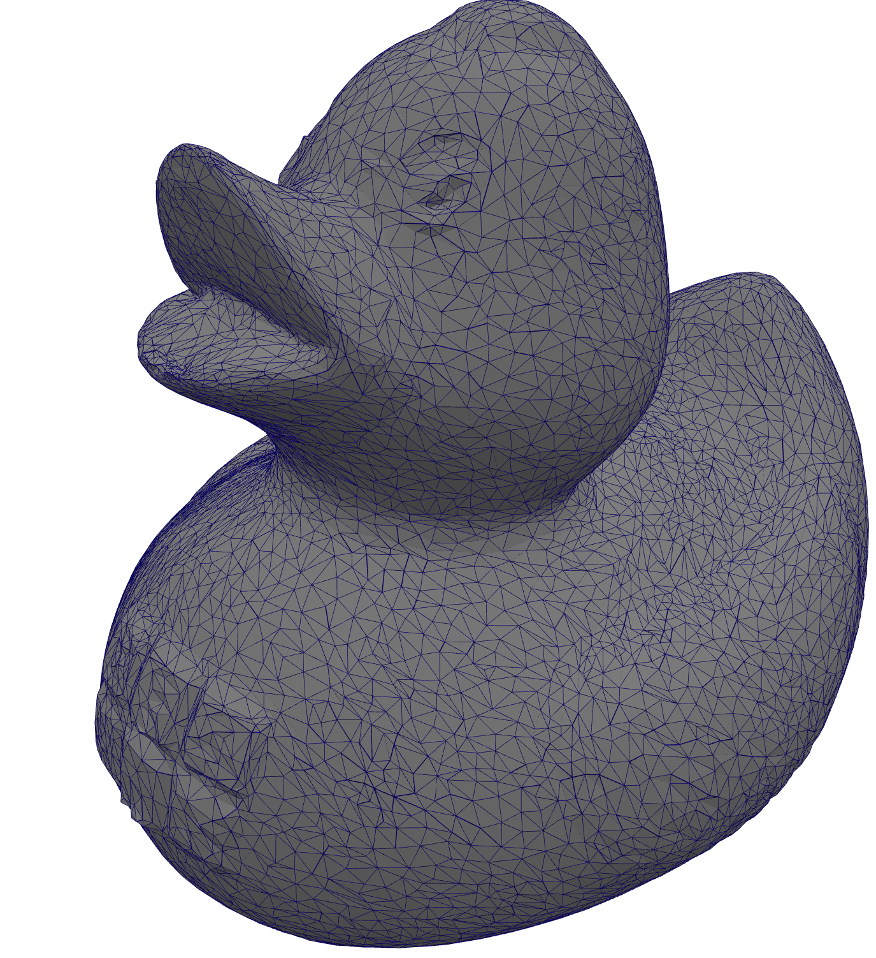
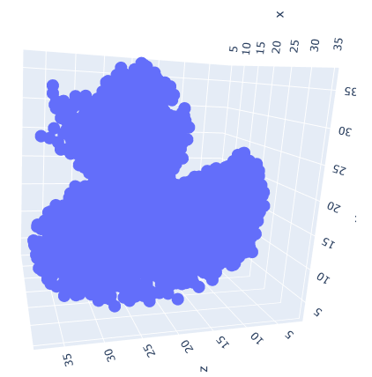
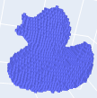
Data preparation
Triangular Mesh
Point Cloud
Voxels

Slide 28
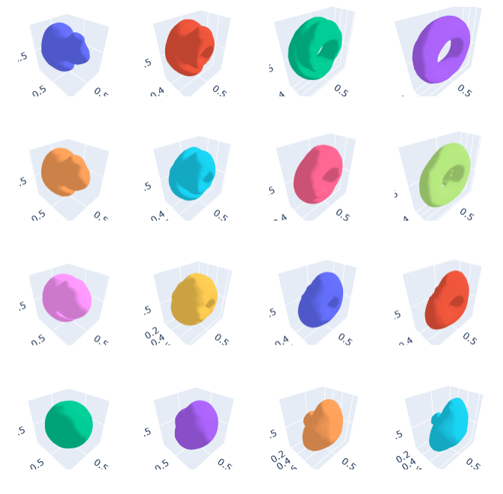
Interpolation and barycenter: 3D

Slide 29
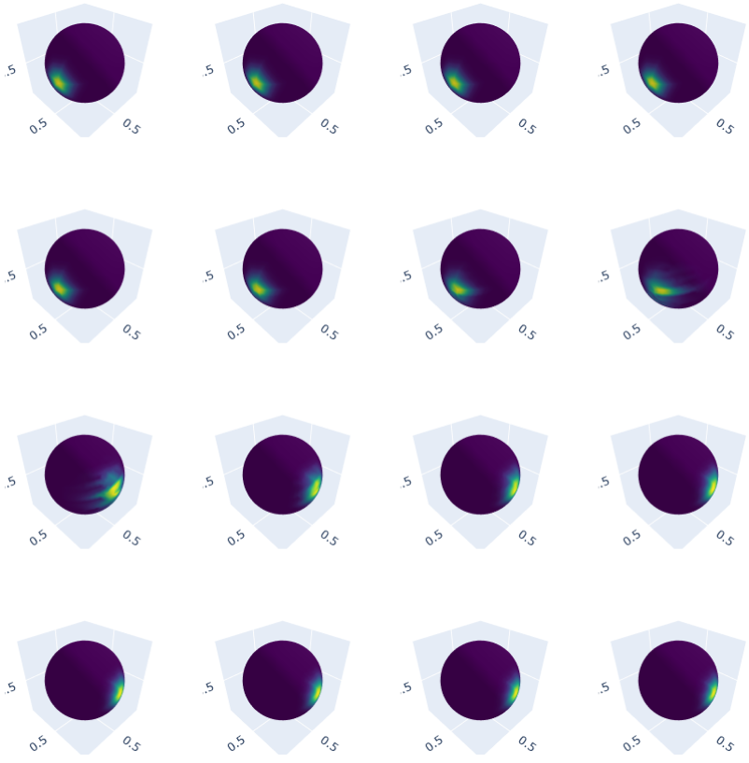
Interpolation and barycenter: 3D

Slide 30

Questions

